Slide 1
Unit 3 E-Government Infrastructure Development (Part 2)

Slide 2
E-government System Architecture
E-government architecture will differ from context to context
For example In the US central government e-government systems architectures must fit within the Federal Enterprise Architecture
There are various way to design the E-government architecture; data model, process model, data/process model etc
We are discussing a basic E-government System Architecture and its element

Slide 3
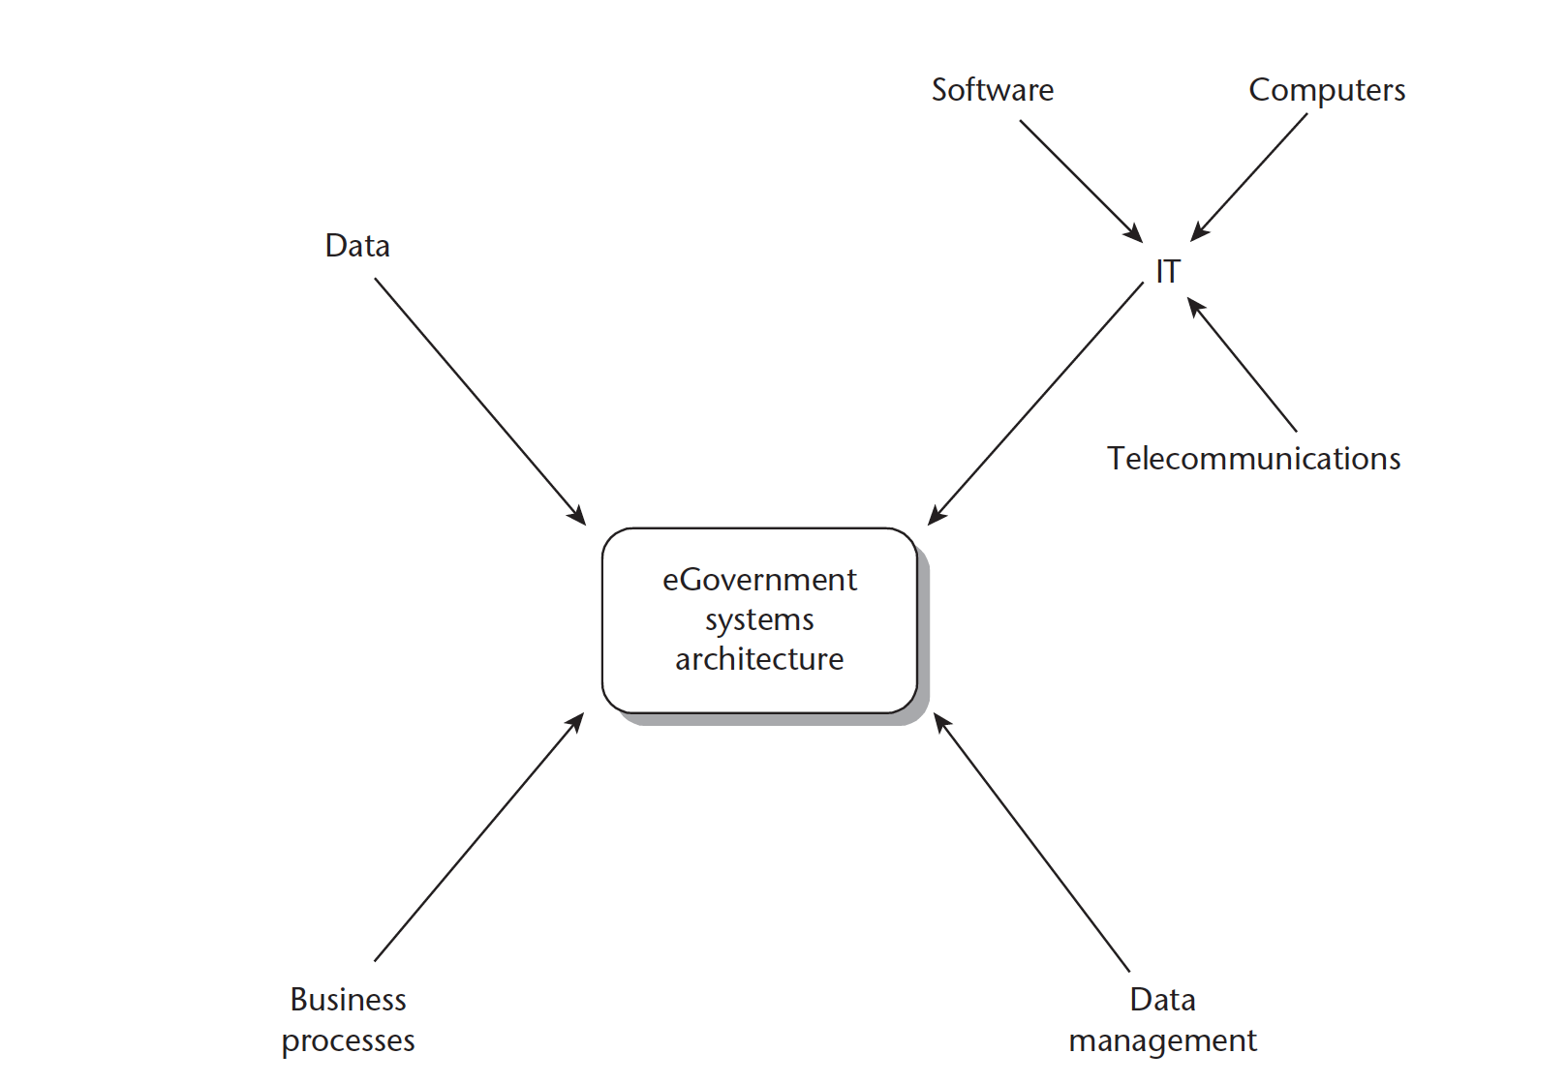
E-government System Architecture

Slide 4
E-government System Architecture
The various elements of the e-government architectures are
Data
Data Management
IT (software, Computers, Telecommunication)
Business Process

Slide 5
E-government System Architecture
At the heart of the system lie data and information which is used and managed by Digital technology(IT).
IT, showing how computers will be sized and connected within the organization,and an outline of the software to be used; Telecommunications for electronic transmission of information over distances
Data management, showing how data capture, input, processing, storage and output functions will be divided across the IT architecture.

Slide 6
E-government System Architecture
Business Process:
Series of the activity taken by the stakeholders to achieve the goals and objective
In order to be a complete sytem there must be people doing activity to achieve a goal of good governance

Slide 7
E-governance Interoperability Framework
What is interoperability ?
Interoperability represents the ability of different heterogeneous organisations to interact towards mutually beneficial goals, involving the sharing of information and knowledge between these organisations, through the business processes they support, by means of the exchange of data between their ICT systems.

Slide 8
E-governance Interoperability Framework
What is interoperability ?
Interoperability represents the ability of different heterogeneous organisations to interact towards mutually beneficial goals, involving the sharing of information and knowledge between these organisations, through the business processes they support, by means of the exchange of data between their ICT systems.

Slide 9
E-governance Interoperability Framework
Why interoperability frame work is needed ?
There is increasing evidence that e-government, if implemented strategically, can improve efficiency, accountability and transparency of government processes.
However, the full potential of e-government applications and other ICTs remains to be fully harnessed by developing countries.
in e-government initiatives, one of the key challenges identified is the existence of a patchwork of ICT solutions in different government offices that are unable to ‘talk’ or exchange data.

Slide 10
E-governance Interoperability Framework
Why interoperability frame work is needed ?
In the process of digitization, government processes and systems are, in many instances, reinforced rather than transformed.
As a result, citizens continue to visit different departments to access public services, even after the introduction of ICTs, as systems are not interconnected.

Slide 11
E-governance Interoperability Framework
Why interoperability frame work is needed ?
Recognizing that e-government should be transformative and become more citizen- rather than government focused in delivering public services, investing in the development of an e-government interoperability framework is fundamental.
In addition to the loss of efficiency, there is a huge loss of resources on developing multiple systems to solve the same problems, as well as on generating the same data from many different places.

Slide 12
E-governance Interoperability Framework
What is Governance interoperability frame (GIF)?
GIF as a set of standards and guidelines that sets out a common language to govern exchange of information between ICT systems.
EGovernment Interoperability is defined as the ability to exchange and reuse government data and information in a uniform and efficient manner across multiple government ICT systems and agencies.
An e-government Interoperability Framework (IF) is a document or group of documents that specify a set of common elements such as vocabularies, concepts, principles, policies, guidelines, recommendations, standards, and practices for agencies that wish to work together, towards the joint delivery of public services.
These standards form the basis of designing e-government services so that administrations, enterprises and citizens can interact efficiently.
IFs are seen by governments as promising instruments to boost the interoperability of their services and systems.
Now days many countries have created and published the Ifs eg, in context of nepal use this site http://nepal.gov.np:8080/NationalPortal/view-page?id=35

Slide 13
E-governance Interoperability Framework
What are principle guideline/ criteria for choosing Standards for the development of the Framework?
Interoperability
Scalability
Reusability
Openness
Market Support
Security
Privacy

Slide 14
Standards for Selection of GIF
Interoperability:-
guaranteeing a media-consistent flow of information between citizens, business, the Government and its partners
selecting only those specifications that are relevant to systems’ interconnectivity, data integration, e-services access and content management

Slide 15
Standards for Selection of GIF
Scalability:-
ensuring the usability, adaptability and responsiveness of applications as requirements change and demands fluctuate

Slide 16
Standards for Selection of GIF
Reusability:-
establishing processes and standards for similar procedures when providing services and defining data structures and that consider the solutions of exchange partners that one has to communicate with, leading to bilateral solutions and agreements
Market support:
the specifications selected are widely supported by the market, and likely to reduce the cost and risk of government information systems
drawing on established standards and recognizing opportunities provided by ICT industry trends

Slide 17
Standards for Selection of GIF
Openness/Transparency:-
the specifications are documented and available to the public at large.
transparency, is having the GIF documentation available to society and the Internet, with mechanisms for dissemination, feedback and evaluation.
Security :-
ensuring reliable exchange of information that can take place in conformity with an established security policy
Privacy
guaranteeing the privacy of information in regard to citizens, business and government organizations, and to respect and enforce the legally-defined restrictions on access to and dissemination of information and ensuring that services need to endure uniform levels of personal data protection

Slide 18
Standards for Selection of GIF
Accessibility:-
is defined in the EIF as ensuring that e-government creates equal opportunities for all through open, inclusive e-services that are publicly accessible without discrimination.
Multilingualism:-
architecture should be linguistically neutral
in cases where this is not possible, provisions should be made for translation.

Slide 19
Cloud governance

